Slide 1
COD492 · B.TECH PROJECT PROGRESS REVIEW
AR Based Dental Imaging and Abnormality Visualization
Faculty Supervisor: Prof. Subodh Kumar
Subhash Malaviya (2023CS10749)· Nishant Jotriwal (2023CS10376)
Indian Institute of Technology Delhi
Notes:
Good [morning/afternoon]. This is our mid-semester progress review for COD492 — AR-Based Dental Imaging and Abnormality Visualization. The project is jointly by Subhash Malaviya and Nishant Jotriwal, under Prof. Subodh Kumar. In short: we are building a live AR overlay that detects, tracks, and measures every visible tooth on a phone camera, entirely on-device — no cloud, no X-ray required.

Slide 2



PROBLEM STATEMENT
Dentists need reliable tooth-level localization to visualize and communicate dental findings. However, identifying and tracking individual teeth in live camera footage is challenging due to motion, viewpoint changes, and overlapping/adjacent teeth.
Abnormality visualization needs every tooth identified individually, tracked live, and measured — not just a mouth.
Everything must run on-device: dental imagery is sensitive, so no camera frame ever leaves the phone or laptop.
Goal: a live AR overlay that detects, tracks, types and measures every visible tooth — the foundation abnormality visualization plugs into.
AR Based Dental Imaging and Abnormality Visualization · COD492
02 / 11
Notes:
Today there is no way to inspect your own teeth at home tooth-by-tooth without a clinic visit. To visualize a dental abnormality like a cavity or crack in AR, you first need to know which tooth is which and how large it is — that is the hard part we are solving. The privacy constraint is strict: dental imagery is sensitive, so the camera feed must never leave the device. Everything runs locally.

Slide 3
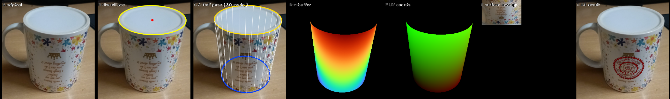
STARTING POINT
Step 1 — proving the core technique on a simple object
Original photo → disc-ellipse fit → full 6-DoF pose from a 3D model → z-buffer → UV coordinates → surface unwrap → composited AR result.
No markers, no depth sensor
Content lives in the object's space
The throughline for Steps 2–3
Full 6-DoF pose estimated from the object's own visible geometry — a single ellipse — in plain video.
Only the camera pose changes per frame — Step 3 applies the same idea to a moving mouth instead of a static cup.
The logo is UV-mapped once, in the cup's own surface coordinates — not a flat sticker re-warped every frame.
AR Based Dental Imaging and Abnormality Visualization · COD492
03 / 11
Notes:
Before tackling teeth, we validated the core AR technique on a simpler object — a cup. We fit an ellipse to the rim to get a full 6-DoF pose without any markers or depth sensor. We then UV-mapped a logo onto the cup's 3D surface so the overlay stays locked to the object, not to the screen. This same pose-from-geometry idea carries forward to the mouth in Steps 2 and 3.

Slide 4
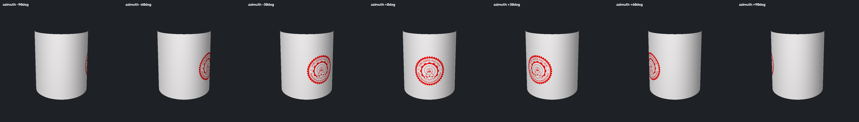
STARTING POINT
Result — and the foundation the rest of the project builds on
Same logo, seven viewing angles — the AR content stays locked to the cup's own surface, not the screen.
Before tooth detection existed: Step 2's mouth anchor
MediaPipe Face Landmarker — a live, 478-point 3D face mesh, entirely on-device
A stable, roll-corrected coordinate frame built from the lips, that survives head motion and changes in distance
Every later stage — the tooth crop, detection, tracking, AR placement — anchors to this one frame, just as Step 1's logo anchored to the cup's UV space
AR Based Dental Imaging and Abnormality Visualization · COD492
04 / 11
Notes:
Here are the results — the logo holds position across seven very different viewing angles. Before tooth detection, we also needed a stable coordinate frame for the mouth. We use MediaPipe Face Landmarker, which gives us 478 3D face points on-device. From the lip landmarks we build a roll-corrected frame that survives head movement and distance changes. Every downstream stage — the crop, the detector, the tracker, AR placement — anchors to that single frame, just as the cup logo anchored to the cup's UV space.

Slide 5

PROGRESS SO FAR
Detecting every visible tooth
Rectified mouth crop
ToothNet-lite (U-Net)
3 predicted maps
Peak seeding
Watershed split
Peaks come from a CenterNet-style center heatmap; touching teeth are separated by a geodesic watershed (Dial's bucket-queue algorithm) grown from those peaks along the predicted tooth mask, out to its boundary map.
125K
~80M
160×120
model parameters
multiply-adds per crop
input crop, on-device
AR Based Dental Imaging and Abnormality Visualization · COD492
05 / 11
Notes:
For detection we trained ToothNet-lite, a tiny U-Net with 125K parameters that runs at 160×120 on the rectified mouth crop. The network outputs three maps simultaneously: a teeth probability mask, an interdental boundary map, and a center heatmap. We seed a watershed from the center peaks to split touching teeth — the same geodesic algorithm used in medical cell segmentation. The whole inference costs roughly 80M multiply-adds per crop, fast enough for real-time use.

Slide 6
PROGRESS SO FAR
Tracking, typing and numbering each tooth
Staying the same tooth, frame to frame
Knowing which tooth it is
Hungarian algorithm (Kuhn–Munkres) finds the optimal frame-to-frame match
Positions are counted outward from the midline per jaw and side, inferring a skipped tooth from the size of the gap
ByteTrack-style two-stage matching recovers low-confidence detections a naive match would drop
That gives incisor / canine / premolar / molar, and a standard FDI number
One-Euro filtering smooths box jitter without lagging behind real motion
Upper vs lower jaw comes from geometry too — the largest gap in vertical position along the arch
AR Based Dental Imaging and Abnormality Visualization · COD492
06 / 11
Notes:
Detection gives us polygons per frame, but we also need to know it is the same tooth frame to frame. We use a Hungarian-algorithm assignment with a ByteTrack two-stage fallback so low-confidence teeth are not dropped. One-Euro filtering removes jitter without adding lag. For tooth identity, we count positions outward from the arch midline and use the gap size to infer skipped teeth. That tells us incisor, canine, premolar, or molar — and gives us the standard FDI tooth number.

Slide 7
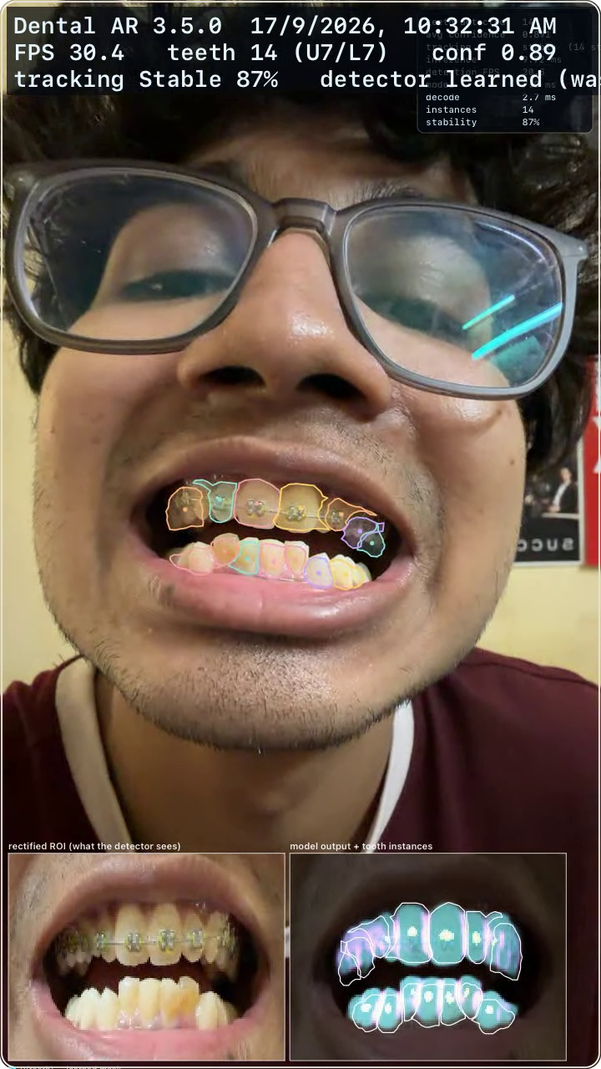
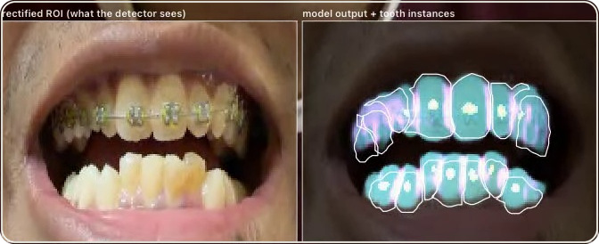
PROGRESS SO FAR
Real-time tracking and tooth debug pipeline
Live camera frame (30.4 FPS, conf 0.89) alongside the rectified ROI and neural watershed debug visualizer.
DETECTOR & SEGMENTER DEBUG VIEW
Rectified mouth crop (160×120) paired with multi-channel model outputs
● P(teeth) learned mask
Cyan probability map (P > 0.5) segmenting tooth enamel
● Interdental boundary
Magenta boundary ridges separating adjacent teeth
● Tooth-centre peaks
Yellow CenterNet peak detections as watershed seeds
● Watershed instances
White contours grown from peaks to split touching teeth
30.4 FPS
Real-Time Inference
2.7 ms decode time, 100% on-device
14 Teeth
Dual-Arch Tracking
7 upper & 7 lower with 0.89 conf
87%
Tracking Stability
ByteTrack + 1-Euro jitter smoothing
Live camera stream · 14 teeth tracked
AR Based Dental Imaging and Abnormality Visualization · COD492
07 / 11
Notes:
This slide shows the full debug view running live. On the left is the raw camera stream with colored AR contours overlaid on each tooth — 14 teeth tracked simultaneously at 30.4 FPS. On the right is the detector's internal view: the rectified 160×120 crop and the three predicted channel maps — cyan for tooth probability, magenta for interdental boundaries, yellow for center peaks, and white contours for the watershed result. Tracking stability is 87% with 0.89 average confidence. The decode step is only 2.7 ms — all on-device.

Slide 8
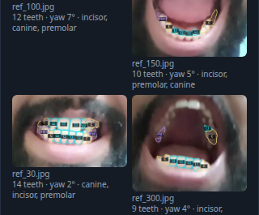
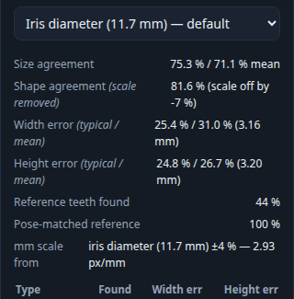
PROGRESS SO FAR
A personal size reference, and a live consistency check
6 reference photos → 69 teeth measured across 9 distinct tooth positions.
A few photos at different angles → every tooth measured and stored as your reference size
The live camera compared against that reference, frame by frame
AR Based Dental Imaging and Abnormality Visualization · COD492
08 / 11
Notes:
After detection and tracking, we built a personal tooth-size reference from just a few calibration photos. Six photos at different angles gave us 69 tooth measurements across 9 distinct tooth types. That reference is stored locally per user. During a live session the camera output is compared frame by frame against that reference, giving an on-the-fly size consistency check without needing any external ruler.

Slide 9
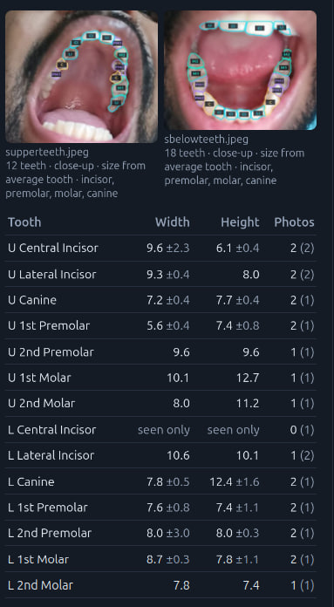
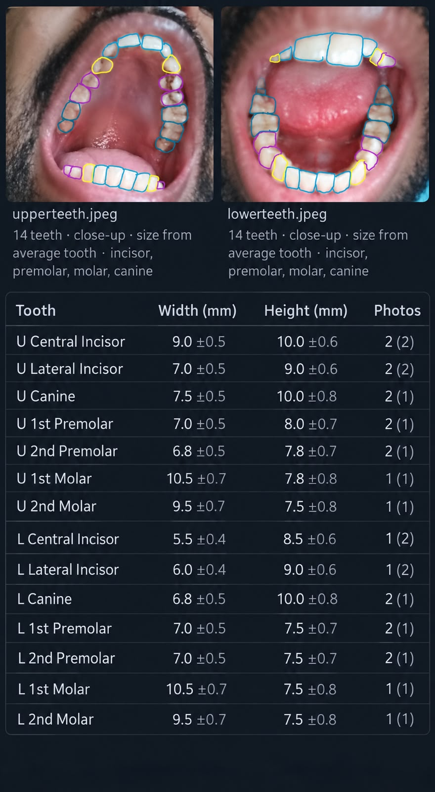
PROGRESS SO FAR
Checked against hand-measured ground truth
Widths agree closely on most teeth — typically within about 1 mm of the hand-drawn measurement
Heights diverge more on some teeth — the close-up crop cuts incisor tips, a known limitation, not hidden here
Model — automatic detection, scaled from average tooth width
Hand-drawn boxes, measured manually as ground truth
AR Based Dental Imaging and Abnormality Visualization · COD492
09 / 11
Notes:
We validated the size estimates against manually measured ground truth. Widths agree within about 1 mm for most tooth types — that is clinically acceptable for an early screening tool. Heights are less accurate on some teeth because the close-up crop cuts off incisor tips. We are not hiding this — it is a known limitation that the next training iteration addresses.

Slide 10

DELIVERABLE
What ships at the end of the semester
Real-time, on-device detection and tracking of every visible tooth, across viewing angles
A personal tooth-size reference from a few calibration photos, plus a live consistency comparison
A documented, reproducible accuracy evaluation — precision, recall, F1, IoU — not unverified claims
A defined interface mapping an external per-tooth result onto a tracked tooth, rendered in AR
clinical diagnosis, or disease / cavity / nerve classification
any image or camera frame ever leaving the device
AR Based Dental Imaging and Abnormality Visualization · COD492
10 / 11
Notes:
By the end of semester we will deliver: 1) real-time on-device detection and tracking across viewing angles; 2) the personal size reference with live comparison; 3) a fully documented accuracy evaluation with precision, recall, F1, and IoU numbers; 4) an interface that maps any external per-tooth result — such as a cavity flag from a classifier — onto the tracked tooth ID in AR. Nothing in this system requires cloud connectivity or shares any image off the device.

Slide 11
PLAN
What can be done
Close the live molar/premolar gap — apply the close-up sweep's lessons to full video, not just calibration photos
1
2
Improve robustness across challenging viewing conditions
Collect and annotate more recordings from this exact setup, to fine-tune the model on its real conditions
3
Prototype the abnormality-visualization interface — map an external per-tooth result onto a tracked tooth ID
4
5
Final documentation, evaluation report, and user testing
AR Based Dental Imaging and Abnormality Visualization · COD492
11 / 11
Notes:
The remaining work has five steps. First, close the molar and premolar detection gap by applying lessons from the close-up calibration sweep to full-video inference. Second, validate on physical phone hardware — all current numbers are from desktop. Third, collect more annotated recordings from this exact real-world setup to fine-tune the model. Fourth, prototype the abnormality visualization interface — mapping a per-tooth result onto a tracked ID in AR. Fifth, finalize documentation, run the evaluation, and do user testing. Thank you.

